Slide 1
Introduction to Spreadsheets

Slide 2
Worksheet Basics

Slide 3
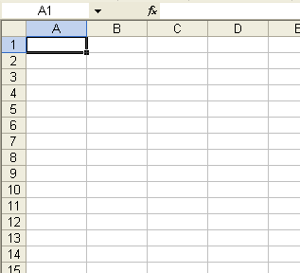
Worksheets
Excel’s main screen is called a “worksheet”.
Each worksheet is comprised of many boxes, called “cells”.

Slide 4
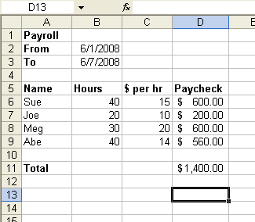
Organize Information
You can organize information by typing a single piece of data into each cell. (see next slides)

Slide 5
How to Enter Information

Slide 6
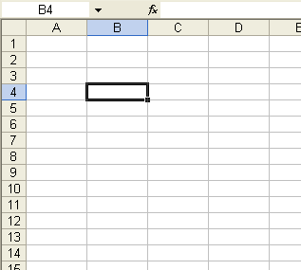
Selecting a Cell
“Select” a cell by clicking on it once (don’t double click).
You can move from cell to cell with the arrow keys or by pressing the “Enter” key.

Slide 7
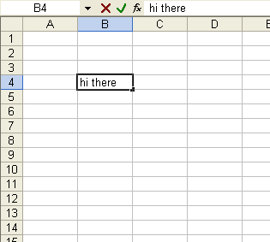
Entering Information / The Formula Bar
To enter information in a cell, just start typing.
When you are done either
Press the Enter Key
Press an arrow key
Click on the “check button” (only visible when entering data into a cell)
The information in the selected cell is also displayed in the “formula bar” above the worksheet.

Slide 8
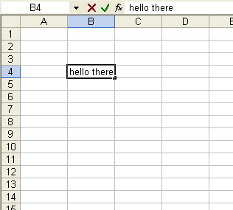
Double Click to Modify a Cell
To modify the contents of a cell double click on the cell.
Then use the right, left arrow keys and the Insert and Delete keys to modify the data.
When you are done:
Press the Enter key or
Click on the check box.
Double click to change “hi there” to “hello there”

Slide 9
Names of Rows, Columns and Cells

Slide 10
Column Names (letters) & Row Names (numbers)
The columns of the worksheet are named with letters
The rows are named with numbers
Selected Cell

Slide 11
Cell Names (ex. B4)
The name of a cell is a combination of the Letter Of The Column that the cell is in followed by the Number Of The Row that the cell is in.
Example: the selected cell in the picture is named B4 (NOT 4B)
Excel automatically shows the the name of the currently selected cell in the “name box” (located above the worksheet).
The letter must come first (i.e. B4, NOT 4B) and there may NOT be any spaces between the letter and the number.
We will learn later why it is important to understand how to name cells.
Name Box
Selected Cell

Slide 12
Longggggggg Data

Slide 13
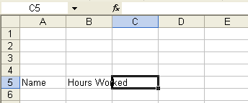
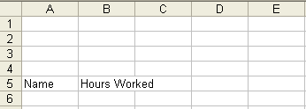
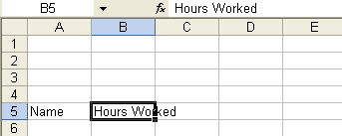
Information that is “too wide” for a cell
The word “Name” is in cell A5
The words “Hours Worked” are in cell B5 (NOT in cell C5). However, since the information is too wide for cell B5, it looks like it extends into cell C5.
You can determine that the information is really only IN cell B5 by selecting cell B5 and looking at the formula bar and then selecting cell C5 and looking at the formula bar.
“Hours Worked” is in cell B5 (look at formula bar)
“Hours Worked” is NOT in cell C5 (formula bar is empty)

Slide 14
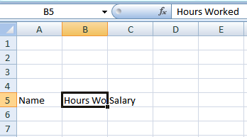
Information that is “Chopped Off”
If there is information in the cell to the right, then the original cell still contains all of the data, but the data appears to be “chopped off”.
You can see the complete data by selecting the cell and looking in the formula bar.

Slide 15
Change the Width of a Column or the Height of a Row

Slide 16
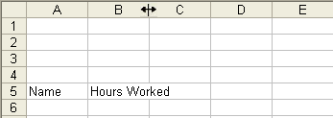
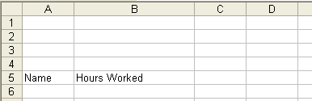
Make a column wider
Drag column separator to the right
To make Column B wider, point the cursor to the column separator between columns B and column C.
The cursor changes to a “Double headed arrow”.
Now, click the left mouse button and without letting go of the button, drag the separator to the right to make the column wider (or to the left to make the column narrower).
Column is now wider

Slide 17

Getting the Exact Width
To get the “exact” width, double click on the separator instead of dragging it.
Double click here
Column is now EXACTLY the correct width

Slide 18
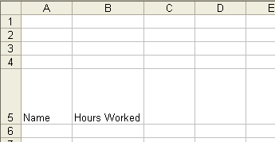
Resizing a Row
Make a row taller or shorter by dragging the separator between the rows.
Click and drag here to resize row 5.
Row is now taller

Slide 19
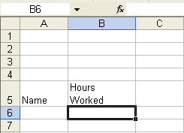
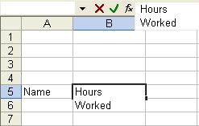
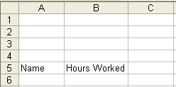
Putting an “Enter” inside a cell
To add a new line inside a cell
Double click inside the cell where you want the new line.
Press Ctrl-Enter (i.e. hold down the Ctrl key and press Enter while still holding down Ctrl).
When you are done editing, press Enter (without holding down Ctrl) to accept the changes.
Step 1: Originally “Hours Worked” is on one line.
Step 2: Double click to edit cell and then press Ctrl-Enter
Step 3: Press Enter (without Ctrl) to accept the changes.

Slide 20
Basic Formatting (e.g. bold, colors, fonts, etc)

Slide 21
Formatting Cells
Select one or more cells and then click on any of the formatting buttons (see below) to change the formatting of the selected cells.
Formatting buttons:
show fewer decimal points (ex. 10.507 is displayed as 10.51)
These change the way numbers are displayed in cells. (these don’t affect words).
show more decimal points (ex. 10.507 is displayed as 10.5070)
indent within cell
put border around cell(s)
center
color of cell
font name
font size
color of text in cell
left justify
right justify
bold
center & merge cells (will explain later)
remove indent
italics
show with commas (e.g. 12345 becomes 12,345)
click on downward pointing arrows for other font names and sizes
underline
click on downward pointing arrows for other colors and border styles
show as percent (ex. 0.5 becomes 50%)
show as currency (ex. 1000.507 becomes $1000.50)

Slide 22
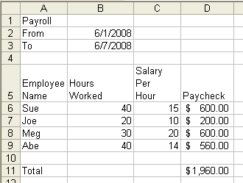
Example – unformatted worksheet
Unformatted worksheet – see next slide for formatting.

Slide 23
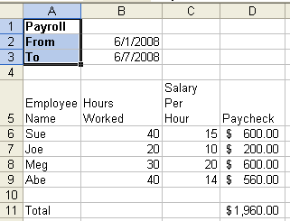
Example –making cells bold
Click on cell A1 and drag to cell A3.
Then press the Bold button to make cells A1,A2,A3 bold.
You could also press the font or background color buttons to change the color or apply any other formatting you like (this is not shown below).

Slide 24
Other Ways of Selecting More Than One Cell
To select a large range of cells, click on the upper left cell in the range. Then hold the shift key and click on the lower right cell in the range.
You can select different “non-contiguous” areas of cells by holding down the Ctrl key while clicking and dragging.

Slide 25
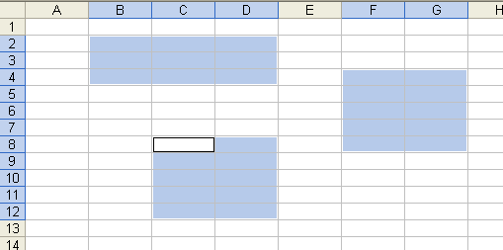
Selecting Non-Contiguous Ranges
Click and drag to select the first range.
Ctrl-click and drag to select additional ranges
(This cell is also selected even though it appears white).

Slide 26
Selecting entire Rows, entire Columns or all cells on the worksheet.
To select an entire column, click on the letter for the column header. To select several columns, click on the header for the first column and drag to the right.
To select an entire row, click on the number for the row header. To select several rows, click on the header for the first row and drag down.
To select all of the cells on the spreadsheet, click on the upper left hand corner of the spreadsheet (where the column headers meet the row headers)

Slide 27
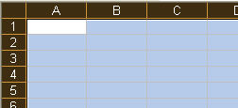
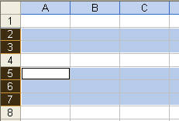




Select Entire Columns/Rows/Worksheet
To select ENTIRE COLUMN B click on “B” column header
To select COLUMNS B,C,D click on “B” column header and drag to right
To select COLUMNS B,C and F,G,H
click on “B” column header, drag to right,
then Ctrl-Click on “F” column header and drag right
To select ENTIRE ROW 2 click on “2” row header
To select ROWS 2,3 and 5,6,7
click on “2” row header, drag down,
then Ctrl-Click on “5” row header and drag down
To select ENTIRE WORKSHEET click on select worksheet button (in corner between “1” and “A” buttons)
Click
Click
Click
drag
Click and drag down
then Ctrl-Click and drag down
Click
Ctrl-Click
Click
drag
drag

Slide 28
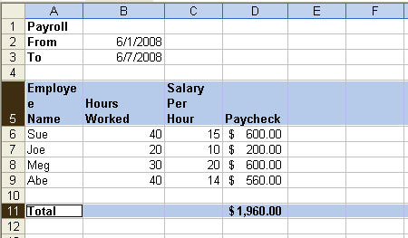
Example - continued
Step 1: Click on row header for row 5
Step 2: Ctrl-click on row-header for row 11
Step 3: Press Bold button or type ctrl-b
Note: After being “bolded”, the word “Employee” is now too wide for the column, so make the column wider if necessary (this step is not shown).

Slide 29
More Advanced Formatting

Slide 30
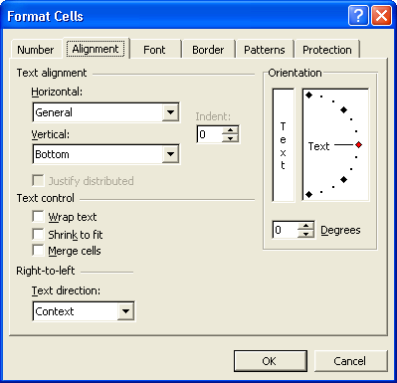
Format Cells
Using the formatting buttons only give you a limited amount of formatting ability.
For more formatting ability, select one or more cells and right click on the selection. Then choose “format cells” from the popup menu.
Choose options from the Number, Alignment, Font, Border and Patterns tabs and press OK to change the way your information looks on the screen.
The Protection tab is used to lock cells so that their contents can’t be modified.
We will not go into the details of using the format cells dialog box at this time but you should be able to figure out most of it by yourself.

Slide 31
Formatting changes how things LOOK, not how they WORK.
NOTE: you will probably not understand this slide until after you learn about Excel Formulas. Formulas are covered later in this presentation.
When you change the format of a cell, Excel still “remembers” the original value.
Excel will use the un-formatted value when calculating formula values.
Example: if you change numbers to appear with fewer decimal points the original number with all of its decimal points are used in calculations.

Slide 32
Formulas
The bread and butter of Excel

Slide 33
Excel Formulas
You must have an equals sign ( = ) as the first character in a cell that contains a formula.
The = sign tells excel that the contents of the cell is a formula
Without the = sign, the formula will not calculate anything. It will simply display the text of the formula.

Slide 34
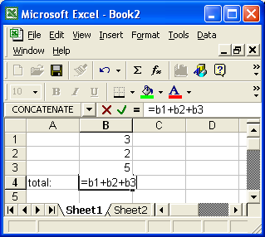
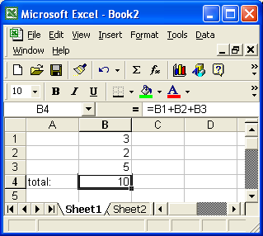
Formulas - correct
formula with = sign
After pressing ENTER

Slide 35
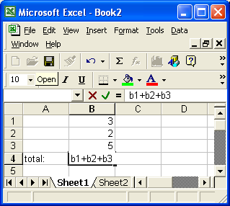
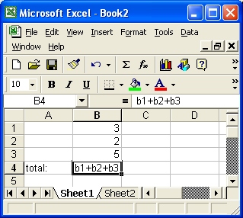
Missing = sign
Missing = sign! Before pressing enter
After pressing ENTER (no change - not a function)

Slide 36
Types of operations
You can use any of the following operations in a formula: operation symbol example
addition: + =a1+3
subtraction: - =100-b3
multiplication: * =a1*b1
division: / =d1/100
exponentiation ^ =a2^2
negation - =-a2+3 (same symbol as subraction)

Slide 37
Explicit (literal) values and cell references
You can use both explicit values and cell references in a formula
An explicit value is also called a literal value
Formula with only cell references: =a1*b1
Formula with only literal values: =100/27
Formula with both cell references and literal values: =a1/100

Slide 38
Errors in Formulas

Slide 39
Common Errors
The following are some errors that may appear in a spreadsheet (there are others too).
#######
Cell is too narrow to display the results of the formula. To fix this simply make the column wider and the “real” value will be displayed instead of the ###### signs. Note that even when the ###### signs are being displayed, Excel still uses the “real” value to calculate formulas that reference this cell.
#NAME?
You used a cell reference in the formula that is not formed correctly (e.g. =BB+10 instead of =B3+10)
#VALUE!
Usually the result of trying to do math with a textual value. Example: =A1*3 where A1 contains the word “hello”
#DIV/0!
Trying to divide by zero. Example: =3/A1 where A1 contains 0 (zero)
Circular Reference
Using a formula that contains a reference to the cell that the formula “lives in”. Example: putting the formula =A1+1 in cell A1 or putting the formula =SUM(A1:B2) in any of the cells A1, B1, A2, B2

Slide 40
Order of Operations

Slide 41
Complex formulas
You can use several operations in one function
You can group those operations with parentheses
Examples
=3*2+1
=c1*(a1+b1)
=(100*a2-10)+(200*b3-20)+30
=(3+2*(50/b3+3)/7)*(3+b7)

Slide 42
Order of operations
When using several operations in one formula, Excel follows the order of operations for math.
first: all parentheses - innermost first
second: exponents (^)
third: all multiplication (*) and division (/). Do these starting with the leftmost * or / and work to the right.
fourth: all addition (+) and subtraction (-). Do these starting with the leftmost + or - and work to the right.

Slide 43
Please Excuse My Dear Aunt Sally
The sentence "Please excuse my dear aunt Sally" is a popular mneumonic to remember the order of operations: Menumonic Meaning
Please parentheses
Excuse exponents
My Dear mulitplication and division (going left to right)
Aunt Sally addition and subtraction (going left to right)

Slide 44
Order of operations
The value of 3 + 2 * 5 is 13 NOT 25!

Slide 45
Order of operations
3 + (100 - 20) / 10 - 6 * 2 / 4 + 9
3 + 80 / 10 - 6 * 2 / 4 + 9
3 + 8 - 6 * 2 / 4 + 9
3 + 8 - 12 / 4 + 9
3 + 8 - 3 + 9
11 - 3 + 9
8 + 9
answer: 17

Slide 46
Cntrl-`
To see the formulas in the worksheet
Press the Cntrl key at the same time as you press the ` key (i.e. Cntrl-`)
Press Cntrl-` again to see the values

Slide 47
Functions

Slide 48
What is a function?
A function is a "named operation"
Functions have
a name
parentheses
parameters/arguments inside the parentheses
The words parameter and argument mean the same thing
you can have many parameters for one function separated with commas (,)
The number of parameters is one more than the number of commas.

Slide 49
The SUM function
Examples Function Result
=SUM(1,2,3,4,5) 15
=SUM(a1,b1,c1) a1+b1+c1
=SUM(9,a1,b2,5,c1) 9+a1+b2+5+c1

Slide 50
Terminology
SUM(1,2,3,4,5)
The name of the function is "SUM"
The parameters or arguments to this function are 1,2,3,4 and 5
The entire thing, i.e. SUM(1,2,3,4,5), is a function call
The value of this function call is 15. Another way to say this is that this function call returns 15.

Slide 51
Ranges (e.g. a1:c3)

Slide 52
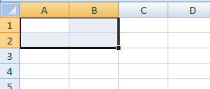
Ranges
A rectangular box of cells is called a “range”.
The name of a range is
the name of the upper left cell of the range
Followed by a colon :
Followed by the lower right cell of the range
Example: A1:B2 is shorthand for A1,A2,B1,B2
See next slide for more examples
A1:B2

Slide 53
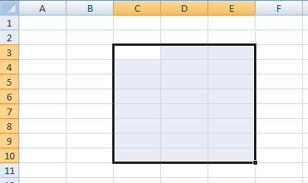
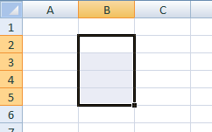
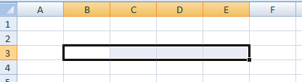
Examples of Range Names
Examples
C3:E10
B2:B5
B3:E3

Slide 54
Using a range as a parameter
Ranges can be specified as a parameters to a function call.
Both of the following function calls produce the same result as =a1+b1+c1+a2+b2+c2+a3+b3+c3+a4+b4+c4 however the 2nd version uses a range and is much shorter. without a range =SUM(a1,b1,c1,a2,b2,c2,a3,b3,c3,a4,b4,c4) with a range =SUM(a1:c4)

Slide 55
Function calls with multiple parameters
You can include multiple ranges and cells as parameters
Example: the following function call has 3 parameters. There are two ranges (a1:b2 and c4:c7), one number (100) and one cell reference (d3) =SUM(a1:b2,100,c4:c7,d3) Is the same as: =SUM(a1,a2,b1,b2,100,c4,c5,c6,c7,d3)

Slide 56
Other Functions

Slide 57
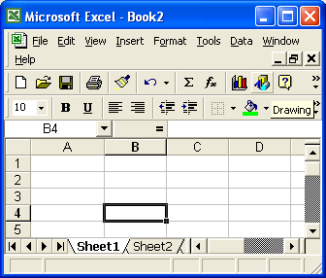
Other functions
Click the function button to see the available functions:
Function buton
brings up the function dialog box (see next slide)

Slide 58
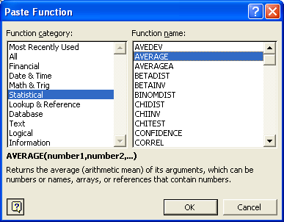
Function dialog box
Warning: this slide was created using Excel 2000. The dialog box in later versions of Excel looks a little different, but it has the same functionality.
categories (i.e. groups of functions)
Functions for the selected category
Description of currently selected function

Slide 59
Function Editor
Double click on the function name to get a dialog box that helps you enter values for the parameters of the function. (see next slide)

Slide 60
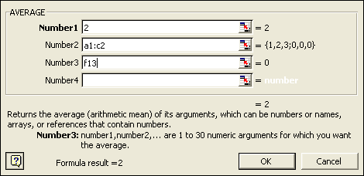
Function Editor
Put values for the parameters in the edit boxes.
When you press OK, this will create the function call: AVERAGE(2,a1:c2,f13)

Slide 61
Example
AVERAGE formula that contains a function value
=AVERAGE(2,4,10,4) 5
=AVERAGE(a1,f32) (a1+f32) / 2
=AVERAGE(a1:c1) (a1+b1+c1) / 3
=AVERAGE(a1:c1,10) (a1+b1+c1+10) / 4

Slide 62
Combining Functions and other values in a single formula

Slide 63
Functions and other values
You can combine functions, cell references and literal values to make a complex Excel formula
Examples
=3 + b23 * SUM(d20:g20)
=SUM(a1,100) * AVERAGE(d10:j10)
=100 / ( AVERAGE(b2,c2,d30) + AVERAGE(f1:f20) )

Slide 64
Other Types of Cell References References to entire ROWs References to entire COLUMNs References to cells or ranges on other worksheets (i.e. tabs)

Slide 65
Entire Rows (e.g. 2:2 or 2:4)
A cell reference of the form <rowName>:<rowName> refers to the range of all the cells for those rows.
Example:
The reference, 2:2, refers to all of the cells on the 2nd row.
The following formula adds up all of the values on the 2nd and 4th rows of the spreadsheet: =sum(2:2,4:4)
Another Example:
The reference, 2:4, refers to all of the cells on the 2nd , 3rd and 4th rows,.
The following formula adds up all of the values on the 2nd, 3rd, 4th , 10th, 11th , 12th, 13th, 14th and 15th rows of the spreadsheet: =sum(2:4,10:15)

Slide 66
Entire Columns (e.g. B:B or B:D)
A cell reference of the form <colName>:<colName> refers to the range of all the cells for those columns.
Example:
The reference, B:B, refers to all of the cells in the 2nd column.
The following formula adds up all of the values in the 2nd and 4th columns of the spreadsheet: =sum(B:B,D:D)
Another Example:
The reference, B:D, refers to all of the cells in the 2nd, 3rd and 4th columns.
The following formula adds up all of the values in the 2nd, 3^{rd,} 4th, 6th and 7th columns of the spreadsheet: =sum(B:D,F:G)

Slide 67
References to cells on other worksheets
Cell on another sheet: sheetName!cellReference
Range on another sheet: sheetName!range
Row on another sheet: sheetName!row:row
Column on another sheet: sheetName!column:column
If a sheet name has a space in it, you must surround the sheet name with apostrophes (i.e. single quotes)
Examples
sheet2!a1
sheet2!b4:c8
'2002 Forecasts'!f3:f10
=sum('2002 Forecasts'!f3:f10)
=sum('2202 Forecasts'!f:f)

Slide 68
More examples
Add up values from 2 different sheets
=sum ( 'great stocks'!b2:c4, 'so so stocks'!b2:c4)
This next one is a little confusing
=sum (a1,a!a1,b1:b4,b1!b4,c!c:c)
Explanation
a1 this is a cell reference on the current sheet a!a1 "a" is the name of sheet. "a1" is a cell on the "a" sheet b1:b4 this is a range on the current sheet b1!b4 "b1" is the name of a sheet. "b4" is a cell on the "b1" sheet c!c:c “c" is the name of a sheet. “c:c" is all of the cells in the c column on the “c” sheet

Slide 69
Absolute and Relative Cell References

Slide 70
Absolute and Relative Cell References
By default, when you copy a formula that contains a cell reference, excel will automatically adjust the cell reference.
You can stop Excel from automatically adjusting the cell reference by using one or more dollar signs ($) in the cell reference. These are called absolute cell references.
A cell reference without a dollar sign is a relative cell reference.

Slide 71
Examples
The following all refer to the same cell
d9
$d$9
$d9
d$9
The only difference between these cell references relates to what happens when you copy a formula that contains the cell reference.

Slide 72
Relative Cell Reference
d9 This is a "relative cell reference".
Changing the column: If I copy this cell reference to another cell:
the "d" will increment one letter for every cell that I move over to the right.
The "d" will decrement one letter for every cell that I move over to the left
Changing the row: If I copy this cell reference to another cell:
the "9" will increment by one for every cell that I move down.
The "9" will decrement by one for every cell that I move up

Slide 73
Absolute cell reference
$d$9 This is an absolute cell reference.
If I copy a formula with this cell reference, the cell reference will NOT change AT ALL.

Slide 74
Mixed References
$d9 and d$9 These are "Mixed" cell references:
$d9
The "d" will stay the same when you copy the cell, but the "9" will change.
d$9
The "d" will change when you copy the cell, but the "9" will stay the same.

Slide 75
Data Types

Slide 76
Data Types
Numeric
values: any number
operators: + - * / ^ %
sample functions: sum( ), average( ), max( ), min( ) etc.
Text (AKA Character or String)
values: Any group of letters or numbers or special characters. Prefix value in cell with an apostrophe ( ' ) to force a text value
operators: & (concatenation)
sample functions: right( ), left(), mid(), lower(), upper(), len(), etc
Dates
values: dates and times operators: N/A
sample functions: now( ), today( ), hour(), minute(), etc.
Logical (AKA boolean)
values: true false
Operators: < > = <> <= >=
sample functions: if( ), and( ), or( ), not( ), isblank()

Slide 77
Data Types for Values in Cells
By default:
a cell that contains a number is treated as numeric data
a cell that contains a date is treated as date data (we'll see more about this later)
a cell that contains data which is not numeric and not a date is treated as "text"

Slide 78
Text Data

Slide 79
Text / String / Character
The following three terms all used to refer to "text" data. All three terms mean the same thing.
text data
string data
character data
This presentation will generally use the term "text data" but you should be familiar with the terms "string data" and "character data"

Slide 80
Text data
Text data is used to store general purpose text (e.g. names, places, descriptions, etc)
You can't do "math" with text values (obviously)

Slide 81
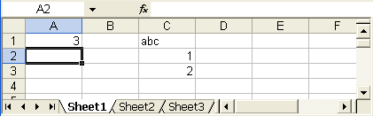
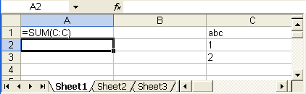
Text isn't part of numerical calculations (obviously)
Formula to add up all numbers in column C
(Same Spreadsheet)
Text data in C1 is not included in the Sum
formula view (press Cntrl-`)
values view (press Cntrl-`)

Slide 82
Text Functions

Slide 83
Text Functions
Many functions are used to manipulate text values.
The following are only some of them
right( ) left( ) mid( ) concatenate( ) lower( ) upper( ) len( )

Slide 84
RIGHT, LEFT and MID functions

Slide 85
RIGHT function
The RIGHT function is used to isolate a specific number of “characters” from the right hand side of a text value.
(example on next slide)

Slide 86


RIGHT ( <text>, <numCharacters>)
Formula View
Values View

Slide 87

RIGHT – numCharacters is optional
The <numCharacters> parameter in the RIGHT function is optional. If you don’t specify it the default is 1 (one).
Formula View
These produce the same results.
Values View

Slide 88
LEFT
The LEFT function is the same as the RIGHT function, but it returns characters from the LEFT side of the value.

Slide 89
MID ( <text>, <startPosition> , <numCharacters>)
MID is used to get values from the middle of some text.
MID takes 3 parameters:
The original text
The position to start taking the new value from
The number of characters to take for the new value
Example on next slide

Slide 90


Example: MID ( <text>, <startPosition> , <numCharacters>)
This example extracts the second through the fourth characters from the original text value:
Formula View
Values View

Slide 91
Concatenation ( & ) and CONCATENATE function

Slide 92


Concatenation (&)
Use & to combine (or concatenate) two different text values
Formula View
Values View
Notice that there is no space between the two values

Slide 93


Concatenate many values
You may concatenate many values together
Formula View
Values View

Slide 94
Concatenation with "literal" values
You can also concatenate "literal" values.
You must include the literal values inside quotes
For example to display spaces in the "full name" in the previous example you could use the following formula. Each space that you want to display must be included in quotes. =A2&" "&B2&" "&C2 (Don't forget any of the &'s )
See next slide ...

Slide 95


Concatenating spaces - Example
You can concatenate spaces into a formula
Formula View
Values View
values contain spaces

Slide 96


LEFT( ) with & in same formula
You can combine the results of different function calls with concatenation.
Formula View
Values View

Slide 97


Putting it all together
In this example we concatenate periods into the initials.
Formula View
Values View
The initials now contain periods

Slide 98
CONCATENATE Function
You can use the CONCATENATE function instead of the ampersand (&).
The following formulas are equivalent: =A1&B1&C1 =CONCATENATE(A1,B1,C1)
The CONCATENATE function can take as many parameters as you like.

Slide 99
More Text Functions:
LOWER UPPER LEN

Slide 100


LOWER ( <textValue> ) UPPER ( <textValue> )
LOWER converts text to lower case.
UPPER converts text to upper case.
Example:
Formula View
Values View

Slide 101


LEN ( <textValue> )
LEN returns a numeric value equal to the number of character in a text value (i.e. the “length” of the text value).
Spaces ARE included in the length.
Example
Formula View
Values View

Slide 102
Dates and Times

Slide 103


How Excel Stores Dates
Dates are stored in Excel as the number of days since Dec 31, 1899 for that date. (ex. Jan 1, 1900 is stored as the number 1).
To see this, type a date in a cell and then press Ctrl-` to see the “formulas view”.
Example
Values View
Formulas View
Dates become numbers in “formulas view”

Slide 104
Times and Dates in the same Cell
A cell can contain both a date and a time.
The value of both the date and the time is stored internally as a single decimal number.
The whole number portion represents the DATE and is the number of days since Dec. 31, 1899
The decimal part represents the TIME and is the fraction of the day that has elapsed.
Examples:
Jan 1, 1900 at 12AM is 1.0 (i.e. 1 day since Dec 31, 1899 and 0 percent of the day elapsed so far)
Jan 1, 1900 at 12PM is 1.5 (i.e. 0.5 of the day elapsed)
Jan 2, 1900 at 12PM is 2.5 (i.e. 2 days since Dec. 31, 1899)
Feb 1, 1900 at 1:05 PM is 32.5451388888889 (i.e. 32 days since Dec 31, 1899 and 0.5451388888889 of the day elapsed by 1:05 PM. This makes sense as it is a little past noon so a little more than half of the day elapsed.

Slide 105


Times and Dates - Example
Values View
Formulas View

Slide 106
Date Arithmetic
You can do arithmetic with dates.
Add and subtract days by adding and subtracting whole numbers.
Add and subtract times by adding and subtracting fractional values.
Examples =A1+7 (one week after the date in A1) =A1-5*7 (5 weeks before the date in A1) =A1- (1/24) (one hour before the time specified in A1) =A1+ (3/24) (three hours after the time specified in A1) =A1+2.5 (two and a half days after the time specified in A1) =A1-A2+1 (the # of days between the date in A1 and the date in A2)

Slide 107
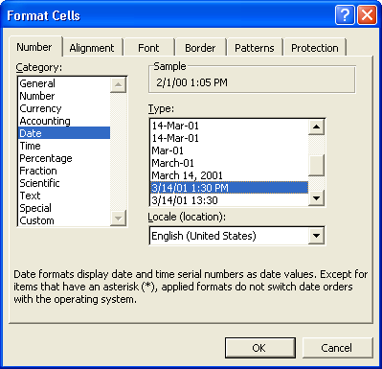
Formatting cells with Dates and Times
Right click on the cell and choose “Format Cells”
From the “Category” list in the “Number” tab either
Choose “Date”, “Time” or “Custom” and choose an appropriate looking format OR
If you choose “General” or “Number”, the internal number for the Date/Time will be displayed in the spreadsheet even in the “values” view.

Slide 108
Logical (AKA boolean) values

Slide 109
TRUE and FALSE
A logical value can be one of only two values TRUE or FALSE

Slide 110
TRUE
The following statements are TRUE:
Fish live in water.
Deer live on land.
The following statements are also TRUE:
3 is greater than 2
2 is less than 3
2 is less than or equal to 3
2 is less than or equal to 2
3 is greater than or equal to 2 3 is greater than or equal to 3
2 is equal to 2
2 is not equal to 3

Slide 111
FALSE
The following statements are FALSE:
Fish live on land.
Deer live in water.
The following statements are also FALSE:
2 is greater than 3
3 is less than 2
3 is less than or equal to 2
2 is greater than or equal to 3
2 is equal to 3
2 is not equal to 2

Slide 112
Logical operators
In Excel the following "operators" are used
Operator Meaning
> greater than < less than >= greater than or equal to <= less than or equal to = equal to <> not equal to
Examples
3 > 2 true
3 < 2 false

Slide 113
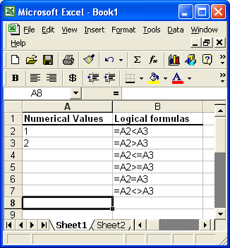
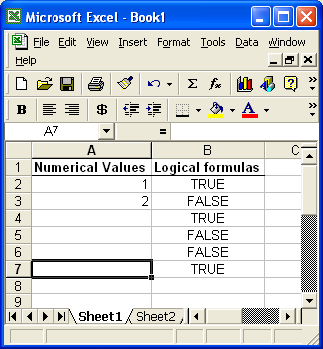
Logical Formulas
Formula View
Values View

Slide 114


Same formulas, different values
Formula View
Values View

Slide 115
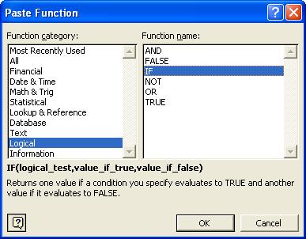
IF Function

Slide 116
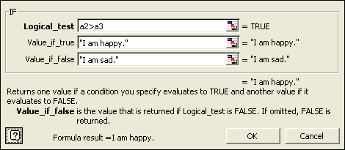
Parameters for IF function

Slide 117
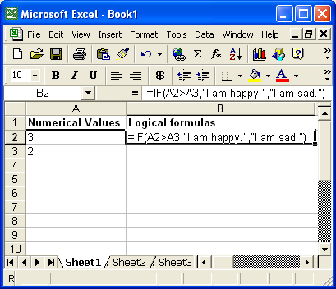
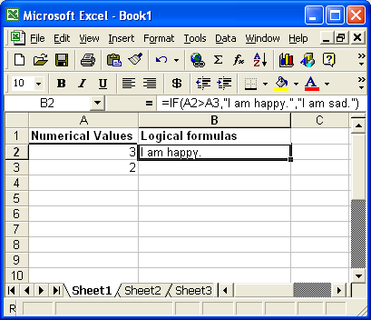
IF function
Formula View
Values View

Slide 118
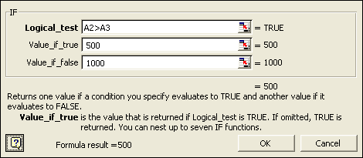
IF with a numeric result

Slide 119
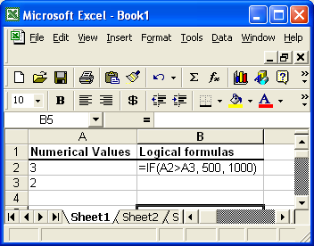
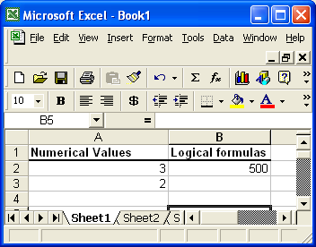
IF with a numerical result
Formula View
Values View

Slide 120
AND OR NOT

Slide 121
AND
The following is TRUE Fish live in water AND deer live on land.
The following are all FALSE Fish live in water AND deer live in water. Fish live on land AND deer live on land. Fish live on land AND deer live in water.

Slide 122
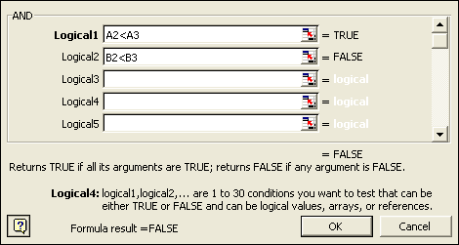
AND function

Slide 123
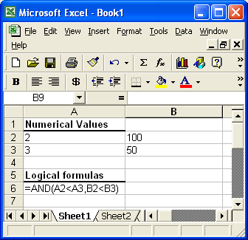
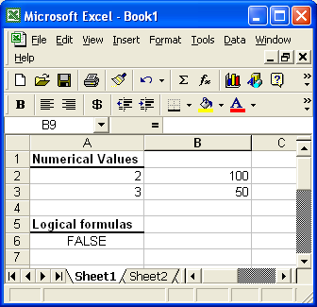
AND
Formula View
Values View

Slide 124
IF with AND - nested function calls
You can use an AND inside of an IF.
This is called a NESTED FUNCTION CALL
Example =IF( AND (A2>A3,B2<>B3) , 500, 1000)
AND is "nested" inside of the IF
These parentheses "belong to" the if

Slide 125
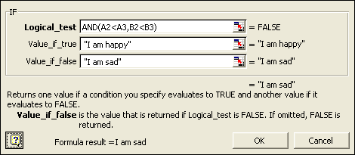
IF with AND - parameters
Parameters for IF function:

Slide 126
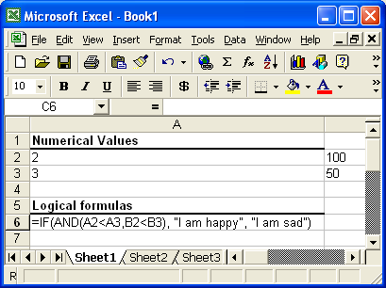

IF with AND - spreadsheet views
Formula View
Values View

Slide 127
AND function
Takes any number of parameters
Returns TRUE if ALL of the parameters evaluate to TRUE otherwise returns FALSE.

Slide 128

OR and NOT functions

Slide 129
OR
Takes any number of parameters
Returns TRUE if ANY of the parameters evaluate to TRUE otherwise returns FALSE

Slide 130
NOT
Takes ONLY ONE parameter
Returns the "opposite" of the value of the parameter
returns FALSE if the parameter value is TRUE
returns TRUE if the parameter value is FALSE

Slide 131
Examples of Complex Nested Function Calls
=IF(AND(A2>A3, OR(B2=B3,C2<C3)), 500, 1000)
=IF(NOT(AND(A2>A3, OR(B2=B3,C2<C3))), 500, 1000)
=IF(AND(A2>A3, NOT(OR(B2=B3,C2<C3))), 500, 1000)

Slide 132
Other Logical Functions: ISBLANK

Slide 133


ISBLANK( <value> )
ISBLANK returns TRUE if the value is blank and false otherwise. (see example below)
Total will be wrong if quantity is blank (since a blank is normally treated as zero)
Total will be correct even if quantity is blank (quantity is assumed to be 1 in that case)
Formula View
blank value
Values View

Slide 134
Using the mouse to create formulas.

Slide 135

Click to choose cell references
Once you type the equal sign (=) you can click with your mouse to enter cell references into a formula.
Example on following slides
Now you can click with your mouse to enter cell references.

Slide 136





Example: click to get cell reference
Type a number in cell A1
type an equal sign (=) in B1
Click on cell A1. You will see a dashed line around cell A1 and the text “A1” (without the quotes) will be entered into the formula in B1. The dashed line indicates that this is the cell reference being entered.
Type a plus sign (+) sign and the dashed line around cell A1 disappears.
You can continue to fill out the rest of the formula now:
Press ENTER to get the result:

Slide 137






Example: changing the cell reference
Type numbers in cells A1 and B1
Type an equal sign (=) in C1
Click on cell A1. You will see a dashed line around cell A1 and the text “A1” (without the quotes) will be entered into the formula in C1. The dashed line indicates that this is the cell reference being entered.
Click cell B1. The dashed line moves to cell B1 and the text in cell C1 changes to “B1”. You can keep clicking on different cells until you click on the right one.
Type a plus sign (+) sign. The dashed line around cell B1 disappears.
If you click on another cell now, a new cell reference will be entered.
You can continue to fill out the rest of the formula now …

Slide 138
Use mouse to enter other types of cell references.
Cell ranges:
Click and drag on a cell to enter a cell range reference
Cells on a different worksheet
Click on a cell on another worksheet to enter a reference from a different worksheet.
Be sure to type the next symbol in the formula (e.g. a plus sign (+) , a comma (,) , etc before you click on the original tab. If you don’t then the formula will be incorrect (try it).

Slide 139
FORMATTING A CELL AS TEXT

Slide 140


Numbers with leading zeros
Sometimes you desire to have to have zeroes displayed at the beginning of a number.
For example, US social security numbers are made up of 9 digits. The first few digits may be zeroes.
This causes in a problem in Excel. When you type in a number with leading zeroes into a cell, Excel removes the leading zeroes when you press Enter.
EXAMPLE: If you type the following into a cell (before you press Enter) When you press Enter you get this:
See next slides for how to fix this …
Leading zeroes are missing

Slide 141
Formatting a cell to display as text
To fix this problem you can “format” the cell to display as “text” instead of as a “number”.
The value will still be able to be used in calculations but it will be displayed on the screen using the rules for text values instead of the rules to display numbers
One of the rules Excel uses to displaying numbers is to remove leading zeroes.
However, if a number displayed as "text" data then Excel WILL display leading zeros.
See next slide for instructions on how to do this …

Slide 142
Opening the "Format cells" dialog box
Select the cell or cells that you want to format as text.
Right click on the selected cell(s) and choose the following from the popup menu format cells or click on a cell and choose the following menu choice
format | cells
Then you will see the "Format Cells" dialog box. (See the next slide ...)

Slide 143

"Format Cells" dialog box
Choose "Text" from the "Number" tab and press the OK button.

Slide 144
Not a Perfect Solution …
When you format the cell as “text” it will display the leading zeroes (you must type them in again).
However, Excel will warn you that a number is formatted as text. (see next slide)

Slide 145


Result of Formatting a Number as Text
Excel indicates this issue with a green triangle in the upper left hand corner of the cell:
If you select the cell you can see the error message.
You can have Excel to ignore this type of “error” by choosing the “Tools | Options” menu choice and unchecking the “Number stored as text” option from the “Error Checking” tab. (this solution is not shown on this slide)

Slide 146
Another Option – using an Apostrophe (‘)

Slide 147
Force a Cell to Display as Text by Using an Apostrophe (')
Another way to display leading zeroes in a number is to type an apostrophe as the first character in the cell.
When you press Enter, the apostrophe is NOT displayed in the cell (it is displayed in the formula bar).
The apostrophe tells Excel that the contents of the cell should be treated as text.
The apostrophe is similar to the = sign.
The = sign tells Excel that the cell contains a formula.
The apostrophe (‘) tells Excel that the cell contains a text value.

Slide 148


Results of Using an Apostrophe
Type an apostrophe followed by the SSN.
Before pressing Enter you can see the apostrophe.
After pressing Enter you can’t see the apostrophe anymore and leading zeroes remain. However, Excel will warn you that a number is formatted as text via the green triangle. (see earlier slides)

Slide 149
Ignoring numbers in calculations

Slide 150
Ignoring numbers in calculations
Typing an apostrophe (‘) as the first character in a cell with a number has the additional effect of causing the number to be ignored in calculations.
NOTE: This does not happen when you format the cell that contains a number to display as text.

Slide 151
Ignoring numbers in calculations.
By default, all numbers are included in numeric calculations.
However, you can force a cell that contains a number to be treated as text and not be included in calculations with numeric functions (ex. SUM, AVERAGE, etc.) by placing an apostrophe as the first character in the cell

Slide 152


Example
Formula to add up all numbers in column D
(Same Spreadsheet)
The Year is incorrectly included in the sum.
formula view (press Cntrl-`)
values view (press Cntrl-`)

Slide 153

Example - continued
To fix the problem you can add an apostrophe (') before the data for the year (no space necessary after the apostrophe).
This will force the number to be treated as text (see next slide).
NOTE: When you stop editing the cell, the apostrophe will NOT be visible in the spreadsheet. However, it will be visible in the formula bar.

Slide 154

Example - finished
The number for the year is now treated as text and is not included in the sum.
The apostrophe in not visible in the spreadsheet (unless you're editing the cell).
The apostrophe IS visible in the formula bar.

Slide 155
The End
Slides after this one are in progress – you can ignore them

